Slide 1
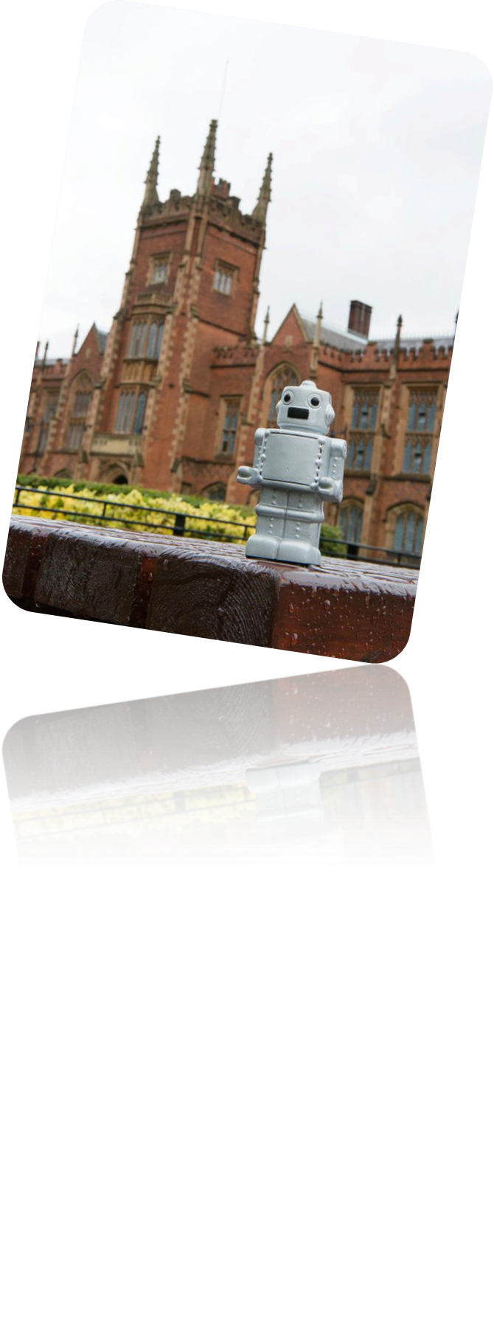
Programming One (csc7050)
Aidan McGowan
Binary – representing numbers and characters

Slide 2
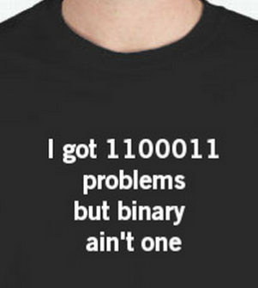
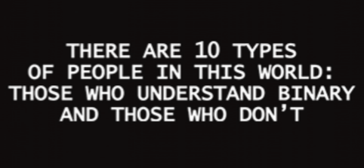
Binary
Notes:
http://www.bbc.co.uk/education/guides/z26rcdm/revision/4

Slide 3
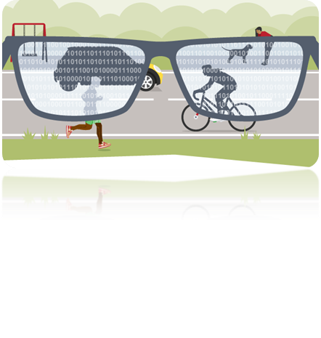
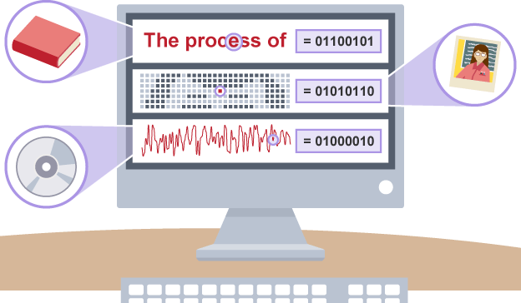
Binary Finary
Computers use electrical signals that are on or off, so they have to see everything as a series of binary numbers. This data is represented as a sequence of 1s and 0s (on and off). All data that we want a computer to process needs to be converted into this binary format.

Slide 4
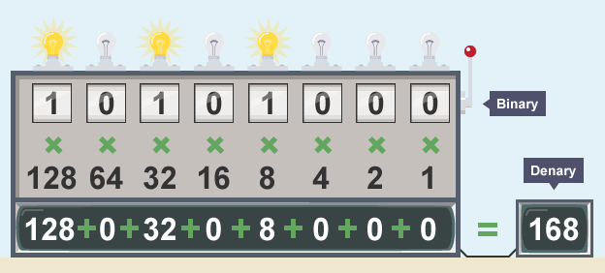
Binary
The binary system is known as a ‘base 2’ system. This is because:
there are only two digits to select from (1 and 0)
when using the binary system, data is converted using the power of two.

Slide 5
Exercises…
(4 bit unsigned binary numbers)
8 | 4 | 2 | 1
1 | 1 | 1 | 0
= 14
8 | 4 | 2 | 1
= 13
8 | 4 | 2 | 1
1 | 0 | 0 | 1
=
8 | 4 | 2 | 1
= 0

Slide 6
Exercises…
(4 bit unsigned binary numbers)
8 | 4 | 2 | 1
1 | 1 | 1 | 0
= 14
8 | 4 | 2 | 1
1 | 1 | 0 | 1
= 13
8 | 4 | 2 | 1
1 | 0 | 0 | 1
= 9
8 | 4 | 2 | 1
0 | 0 | 0 | 0
= 0

Slide 7
Binary arithmetic
There are four rules that need to be followed when adding two binary numbers. These are:
0 + 0 = 0
1 + 0 = 1
1 + 1 = 10 (binary for 2)
1 + 1 + 1 = 11 (binary for 3)

Slide 8
Binary arithmetic
0101 (5)
+ 0010 (2)
______
0111 (7)
0011 (3)
+ 1011 (11)
______
1110 (14)
0111 (7)
+ 0001 (1)
______
1000 (8)
0001 (?)
+ 1110 (?)
______
(?)
01010110 (?)
+ 01100001 (?)
_________
(?)
01000110 (?)
+ 01000001 (?)
_________
(?)

Slide 9
Binary arithmetic
0101 (5)
+ 0010 (2)
______
0111 (7)
0011 (3)
+ 1011 (11)
______
1110 (14)
0111 (7)
+ 0001 (1)
______
1000 (8)
0001 (1)
+ 1110 (14)
______
1111 (15)
01010110 (86)
+ 01100001 (97)
____________
010110111 (183)
01000110 (70)
+ 01000001 (65)
_________
10000111 (135)

Slide 10
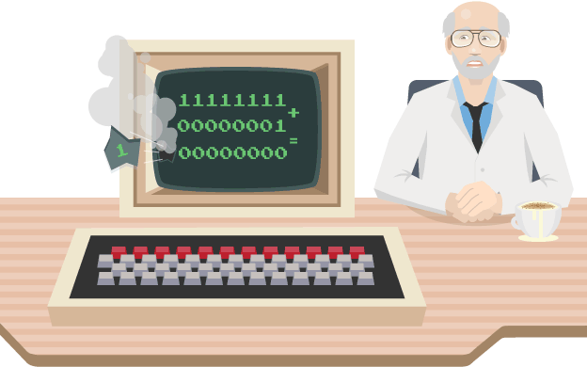
Overflow error – exceptional!
0111 (?)
+ 1001 (?)
______
(?)

Slide 11
Overflow error – exceptional!
0111 (7)
+ 1001 (9)
______
1 0000 (16) ?
Byte data type is an 8-bit signed two's complement integer.
Minimum value is -128 (-2^7)
Maximum value is 127 (inclusive)(2^7 -1)
Notes:
byte myByteA = 127;
byte myByteB = 2;
byte answer = (byte) (myByteA + myByteB);
System.out.println("Answers is "+answer);

Slide 12
Sign and magnitude
Left (most significant bit) represents the sign
The sign is either positive (0) or negative (1)
+ / - | 64 | 32 | 16 | 8 | 4 | 2 | 1
0 | 0 | 0 | 0 | 0 | 0 | 0 | 0
= 0
0 | 0 | 0 | 0 | 0 | 0 | 0 | 1
= ?
0 | 0 | 0 | 0 | 0 | 1 | 0 | 1
= ?
1 | 0 | 0 | 1 | 1 | 0 | 0 | 0
= ?

Slide 13
Sign and magnitude
Left (most significant bit) represents the sign
The sign is either positive (0) or negative (1)
+ / - | 64 | 32 | 16 | 8 | 4 | 2 | 1
0 | 0 | 0 | 0 | 0 | 0 | 0 | 0
= 0
0 | 0 | 0 | 0 | 0 | 0 | 0 | 1
= +1
0 | 0 | 0 | 0 | 0 | 1 | 0 | 1
= +5
1 | 0 | 0 | 1 | 1 | 0 | 0 | 0
= -24

Slide 14
Sign and magnitude arithmetic
00000101 (+5)
+ 00000010 (+2)
______________
(+7)
00000101 (+5)
+ 10000010 (-2)
__________
????????? (+3) ?

Slide 15


Sign and magnitude arithmetic
00000101 (+5)
+ 00000010 (+2)
______________
00000111 (+7)
00000101 (+5)
+ 10000010 (-2)
__________
100000111 (+3) ?

Slide 16
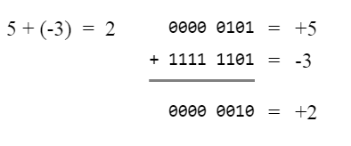

Representing negative numbers – Two’s complement
8 bit signed Two’s complement range (01111111) 127 to -128 (10000000)
Take the denary number and represent it in binary … e.g. -12
01100 (using 5 bits- left most bit is the sign bit)
Then we invert the digits. 0 becomes 1, 1 becomes 0.
10011
Then we add 1.
10011
+ 1
---------
10100 (-12)
1

Slide 17

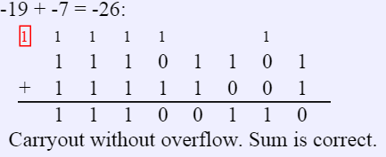
The Bit Bucket !

Slide 18
Convert Two’s Complement negative binary number to denary
1011 – is negative…
Convert 0s to 1’s and 1’s to 0’s
1100
+ 1
------
1101 (-5)

Slide 19
Two’s complement Binary arithmetic
0101 (5)
+ 0010 (2)
______
0111 (7)
0001 (+1)
+ 1011 (?)
______
(?)
0111 (?)
+ 1001 (?)
______
(?)
0001 (?)
+ 1110 (?)
______
(?)
01010110 (?)
+ 11100001 (?)
__________
(?)
01000110 (?)
+ 01000001 (?)
_________
(?)
Notes:
1011
100
+ 1
____
1101 (-5)

Slide 20

Two’s complement Binary arithmetic
0101 (+5)
+ 0010 (+2)
______
0111 (+7)
0001 (+1)
+ 1011 (-5)
______
1100 (-4)
0111 (+7)
+ 1001 (-7)
______
1 0000 (0)
0001 (+1)
+ 1110 (-2)
______
1111 (-1)
01010110 (+86)
+ 11100001 (-31)
__________
100110111 (+55)
01000110 (+70)
+ 01000001 (+65)
__________
10000111 (+135 ?)
Caution Overflow with this one !
Notes:
Translate –Bin to denary
1100
011
+ 1
____
1 1 0 0 (-4)

Slide 21
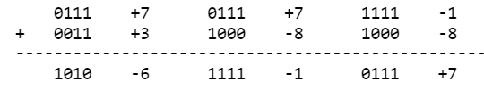


Overflow Detection
Overflow in two's complement is determined by a result with the wrong sign. I.e., if you add two positives and get a negative result, or add two negatives and get a positive.
It is not possible to get an overflow when adding numbers of opposite signs!

Slide 22
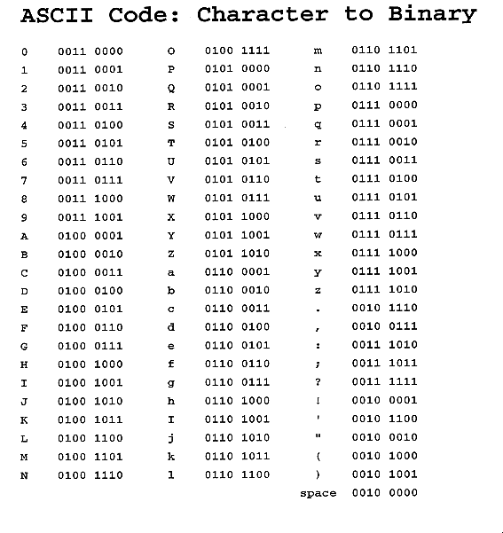
Representing characters – ASCII and Unicode
Most modern character-encoding schemes are based on ASCII, though they support many additional characters. Unicode is a standard which defines the internal text coding system in almost all operating systems used in computers at present. Unicode assigns each character a unique number, or code point.

Slide 23
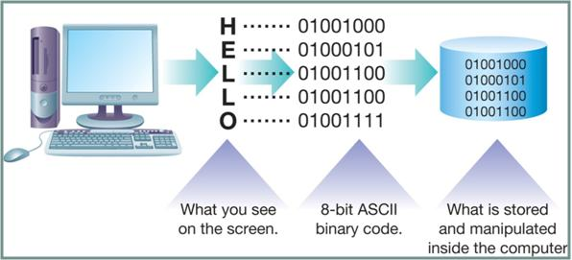
ASCII / UTF translation

Slide 24
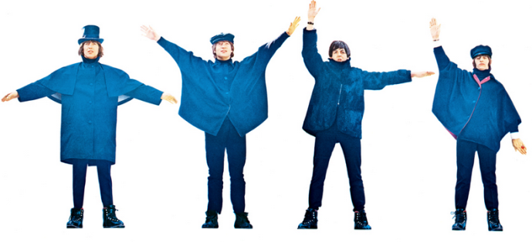
Try this out …
01010111 01101001 01101110 01100001 01110000 01110010 01101001 01111010 01100101 00101110 01000010 01100101 00110010 00110001 01110011 01110100 01110100 01101111 01100101 01101101 01100001 01101001 01101100 01000001 01101001 01100100 01100001 01101110 01000010 01101001 01101110 01100001 01110010 01111001 01000110 01101001 01101110 01100001 01110010 01111001
Notes:
https://www.branah.com/ascii-converter

Slide 25
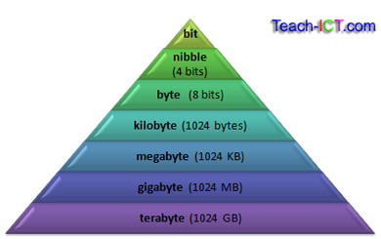
Size up !

